Slide 1
MIR Lab
Ninad Doshi

Slide 2
Topics Covered
Nvidia (PilotNet)
Transfer Learning (ResNet)
Recurrent Neural Network (LSTM)
Datasets
Salient Features

Slide 3
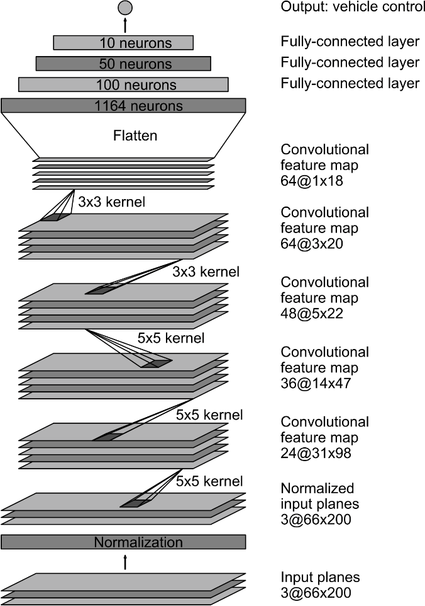
Nvidia (PilotNet)

Slide 4
Deep Residual Learning
The biggest issue with very deep neural networks is that the vanishing gradients and so the network fails during training
“Deep Residual Learning for Image Recognition” in Dec 2015 gave a solution to it

Slide 5
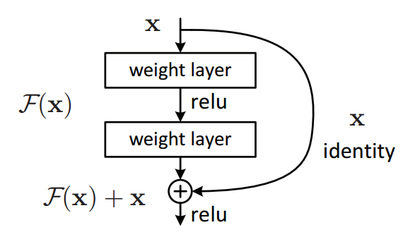
Deep Residual Learning
Building block of residual learning

Slide 6
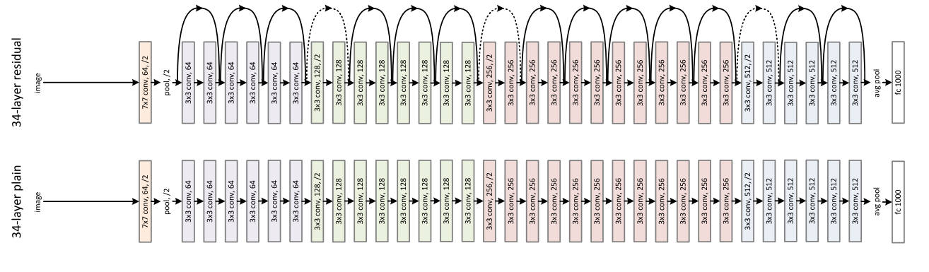
Deep Residual Learning
34 layer plain and residual network

Slide 7
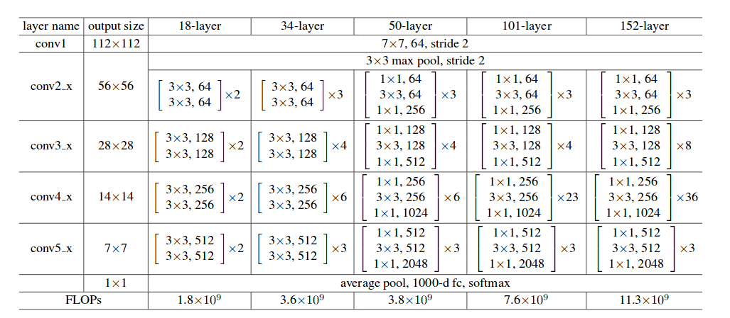
Deep Residual Learning
ResNet Architecture

Slide 8
Transfer Learning
Transfer Learning is a research problem in machine learning that focuses on storing knowledge gained while solving one problem and applying it to a different but related problem
Transfer learning is the reuse of a pre-trained model (fully or partially) on a new problem

Slide 9
Transfer Learning in ResNet
The concept is that in the starting layers the network learns to detect edges and textures
In the middle layers it learns to detect shapes and parts of the object
In the final layers it learns to detect different objects

Slide 10
Transfer Learning in ResNet
Different possibilities and ways of training
Train the network with new data
Initialize the weights with the pretrained weights and update them according to our data
Initialize the weights with the pretrained weights and update the part of the network according to our data by freezing nontrainable layers
Use the part of the pretrained network and give the output of the pretrained network to our network architecture.

Slide 11
Transfer Learning in ResNet
I have implemented the last method; use the weights of pretrained network and give the output of the pretrained network to our network architecture.
Pretrained model till ‘activation 10’ layer of ResNet50 is used and then network architecture similar to Nvidia is attached to its end.

Slide 12
Recurrent Neural Network
A recurrent neural network is a class of neural networks where connections between nodes of every data is made to store the temporal sequence
We don’t start thinking from scratch every second. We keep the context of the past data to predict the next outcome
Traditional neural networks are incapable of doing it. They consider every data as a new data for predicting the output
Recurrent neural networks can address this issue

Slide 13
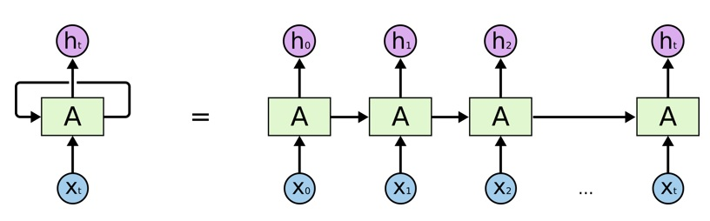
Recurrent Neural Network
This chain like nature reveals that recurrent neural networks remembers the past data to predict the future outputs

Slide 14
Recurrent Neural Network
Sometimes it is required that the past information is of no use and needs to be forgotten, or very old information is also useful and needs to be remembered.
This is the biggest drawback of conventional RNN as it cannot forget the close past data and cannot remember very old data.
So, LSTM (Long and Short Term Memory) type of RNNs were developed

Slide 15
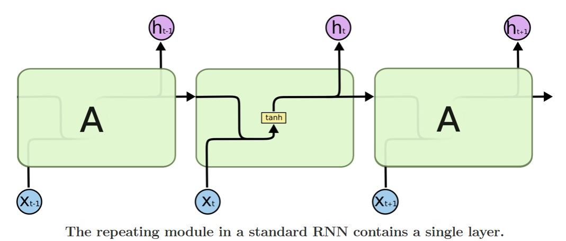
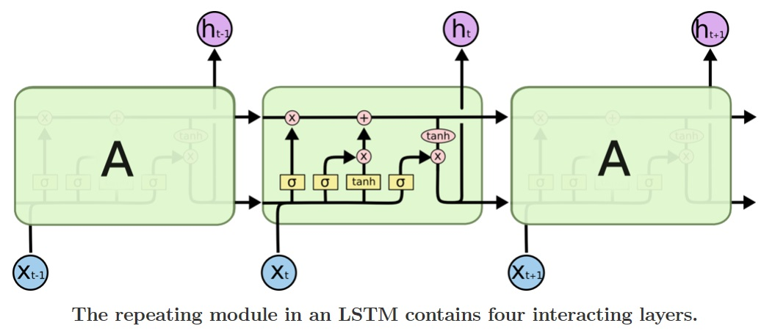
Long and Short Term Memory

Slide 16
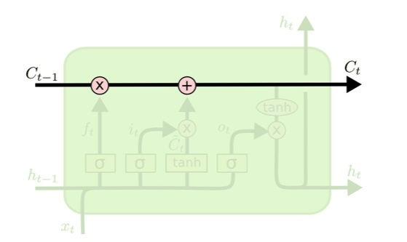
Long and Short Term Memory
LSTM have the ability to add or remove information to the cell state by structures called gates
The cell state is kind of like a conveyor belt
It runs straight down the entire chain, with some linear interactions

Slide 17
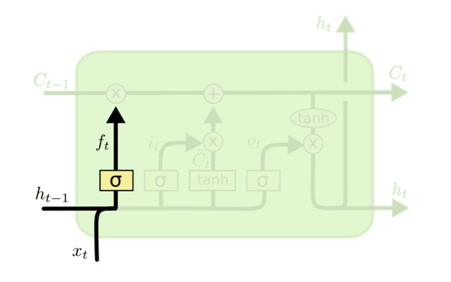
Forget Gate
The first step is to decide what information we’re going to throw away from the cell state

Slide 18
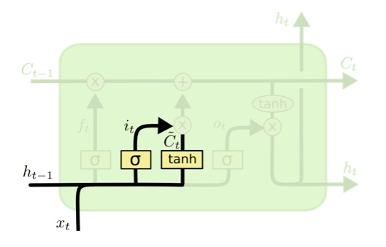
Input Gate
The next step is to decide what new information we’re going to store
This has two parts: sigmoid layer decides which value will be updated and tanh layer creates a vector of new value

Slide 19
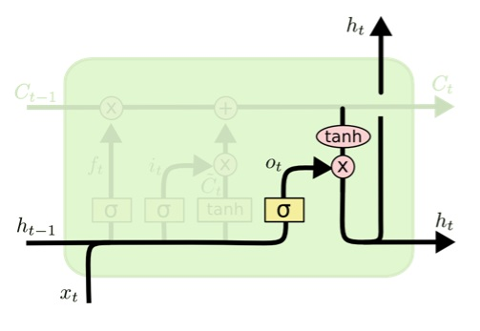
Output Gate
Finally, we decide what we’re going to output
This output will be based on our cell state, but will be a filtered version

Slide 20
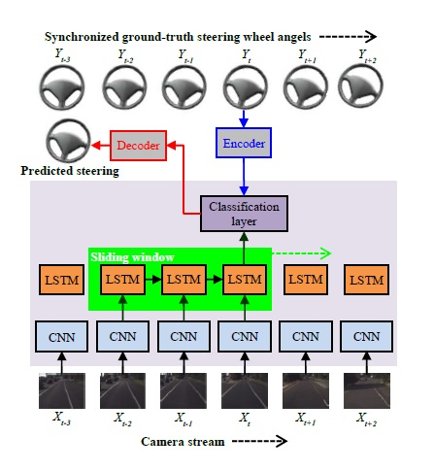
LSTM for steering angle prediction

Slide 21
LSTM Architecture
I am using two variants of basic Nvidia architecture with LSTM layer.
Time Distributed layers are used to perform CNN with every image.
In one of the variants, LSTM layer is placed after CNN and then Dense layers.
In another variant, LSTM layer is places exactly before the last Dense layer.

Slide 22
Salient Features
Salient features are the features in the image which activates the neurons or which are responsible for the final output
We have three ways of visualizing salient features: which increases output, decreases output and maintains the output
In our case left steering is positive and right steering is negative

Slide 23
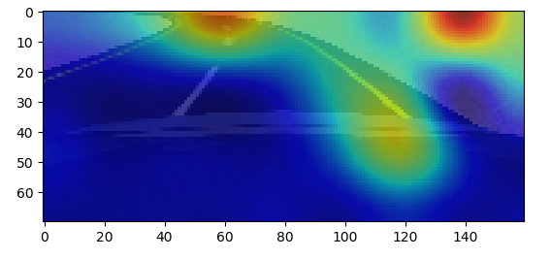
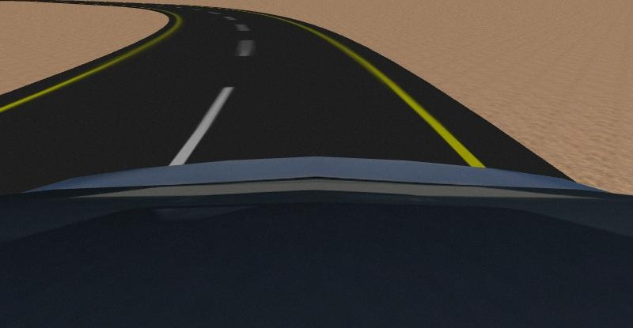
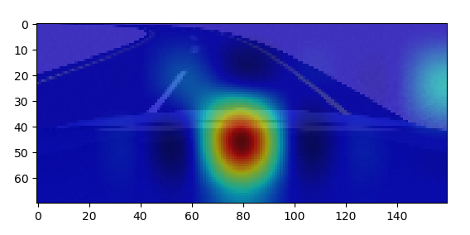
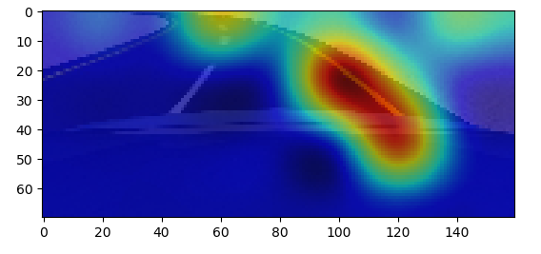
Left Turn

Slide 24
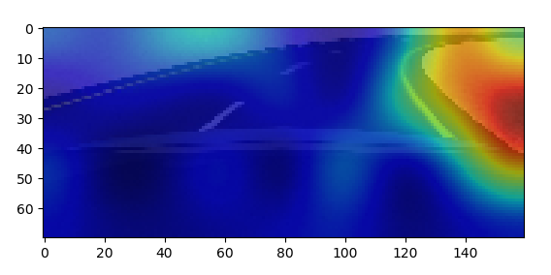
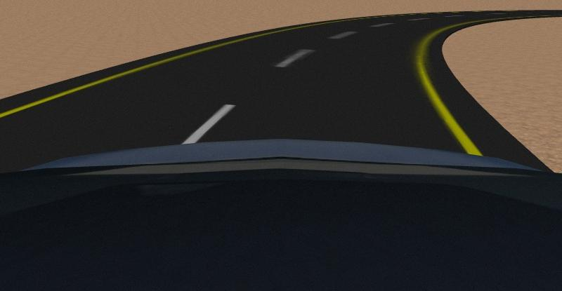
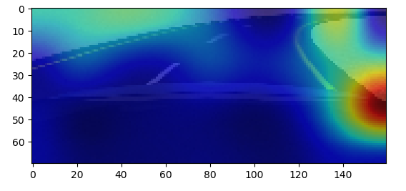
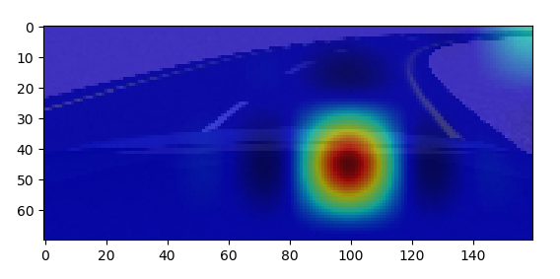
Right Turn

Slide 25
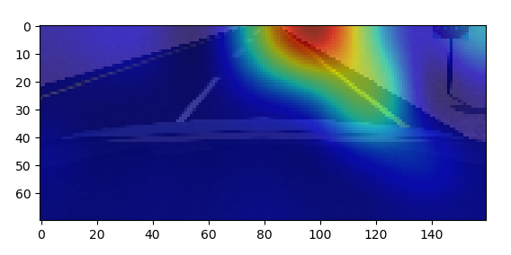
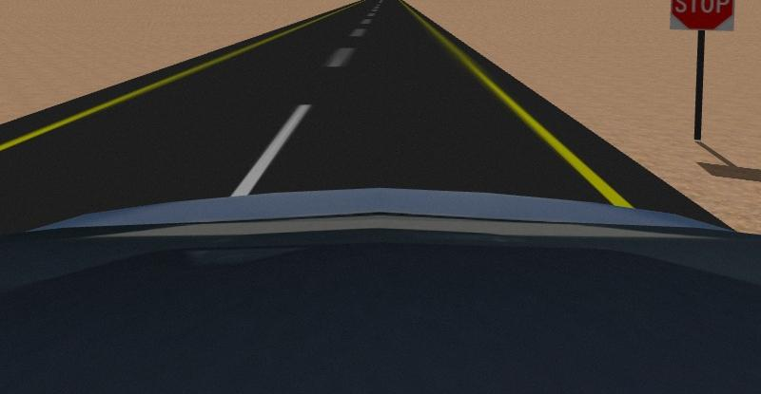
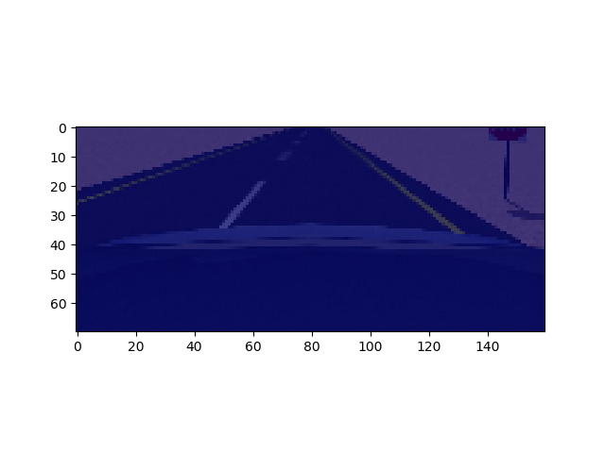
Straight

Slide 26
Thank You

